Slide 1
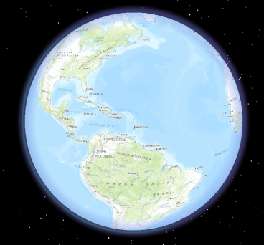
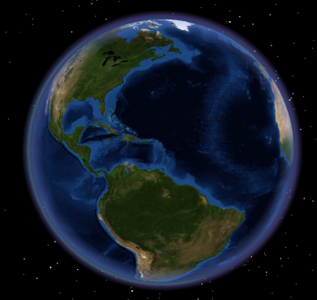
GIS Tutorials for Watershed Management
Andrea Bolks, Jared O’Brien, Adam Thada
Indiana Watershed Leadership Academy
May 2013

Slide 2
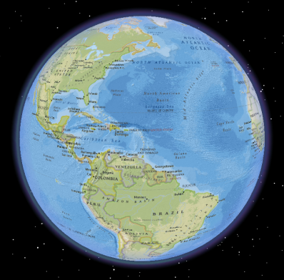
Goal
Create a watershed management-oriented tutorials to show spatial data. Programs include ArcGIS Desktop, ArcGIS Explorer , ArcGIS Online and Data 2 Maps and are focused for those with average computer competency.
Create a product that can be built upon in the future by others in the IWLA
Notes:
Explain our target audience

Slide 3
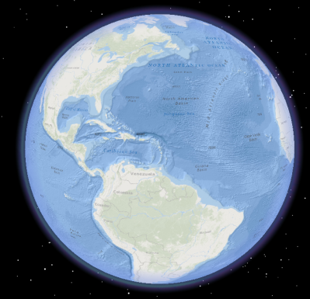
Guides
ArcGIS Explorer Guide1: Site Locations Map
ArcGIS Online Guide1: Site Locations Map
ArcGIS Online Guide 2: Watershed Boundary Map
ArcGIS Guide: Adding x,y Locations
Data2Maps (D2M) Large Sample Size Guide
Notes:
Explain our target audience

Slide 4
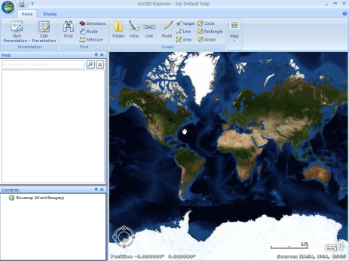
Why ArcGIS Explorer Desktop?
http://www.esri.com/software/arcgis/explorer
Why?
Free!
Compatible with numerous basemaps and layers already available
Customizable – use your own data
Map production
Spatial analysis
Can handle large datasets
Notes:
Explain why we picked ArcGIS

Slide 5
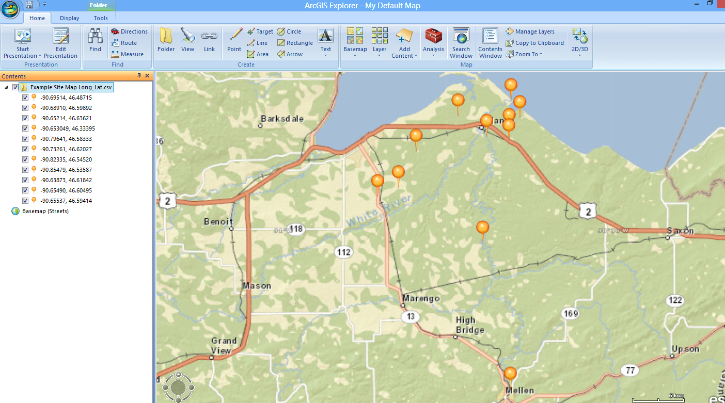
ArcGIS Explorer Guide1: Site Locations Map
Notes:
Explain why you would want to do this

Slide 6
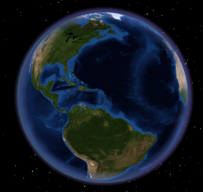
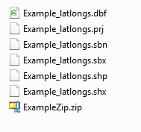
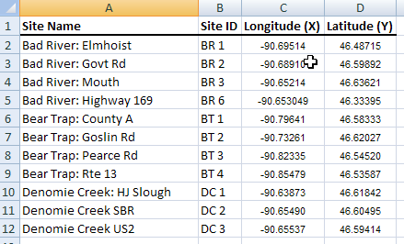
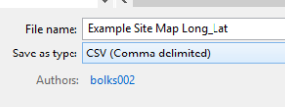
Download and Open ArcGIS Explorer
2. Add Sampling Locations Options:
Adding a shapefile of your sampling locations (a shapefile that was already created in a GIS program such as ArcMap)
B) Adding sites with a text file of x,y locations (that can be created using excel or another spreadsheet tool)
C) Drawing point “notes” in Explorer

Slide 7
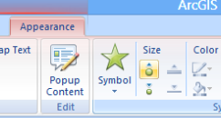
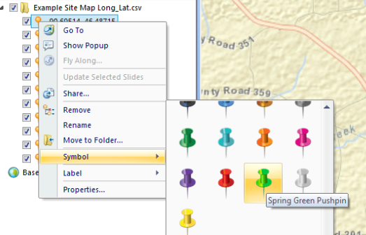
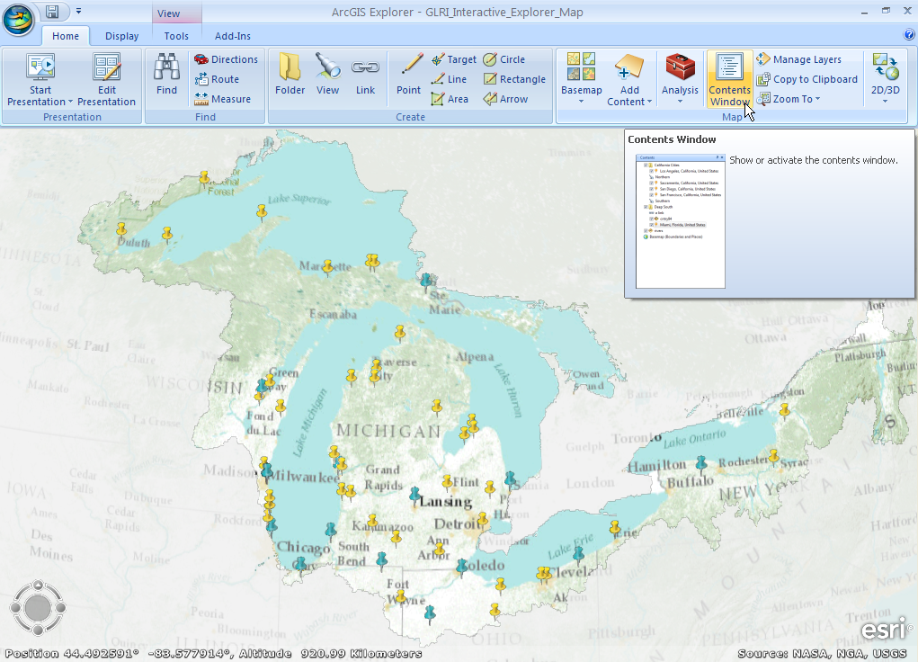
3. Changing the Symbology:

Slide 8
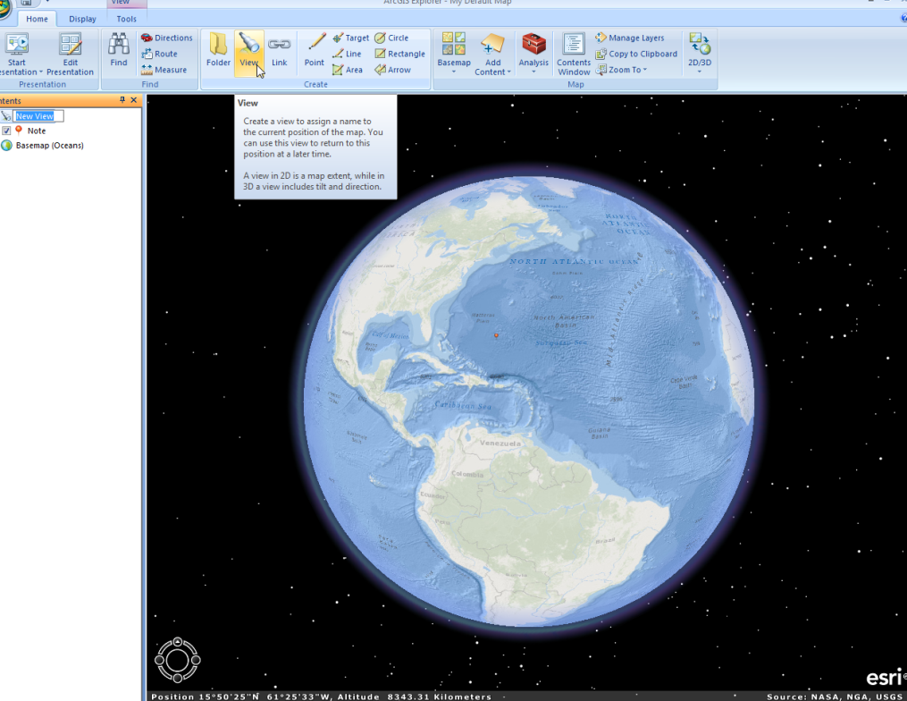
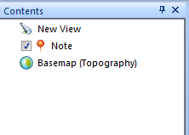
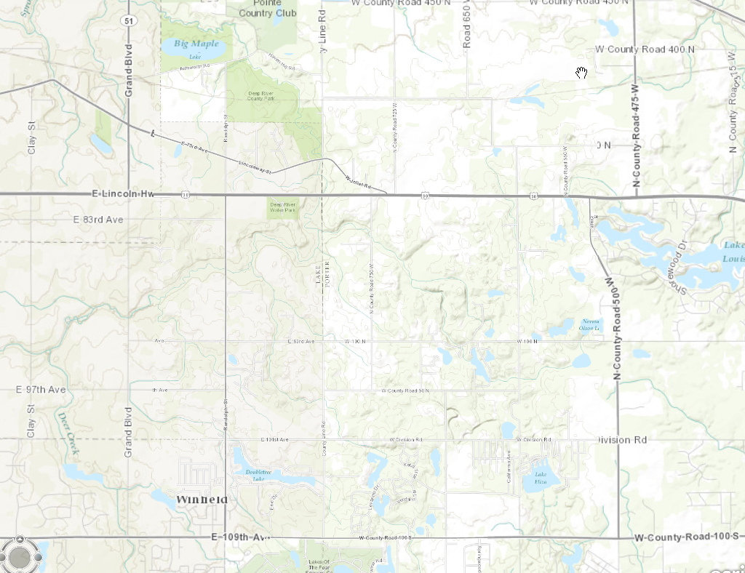
4. Setting the View:

Slide 9
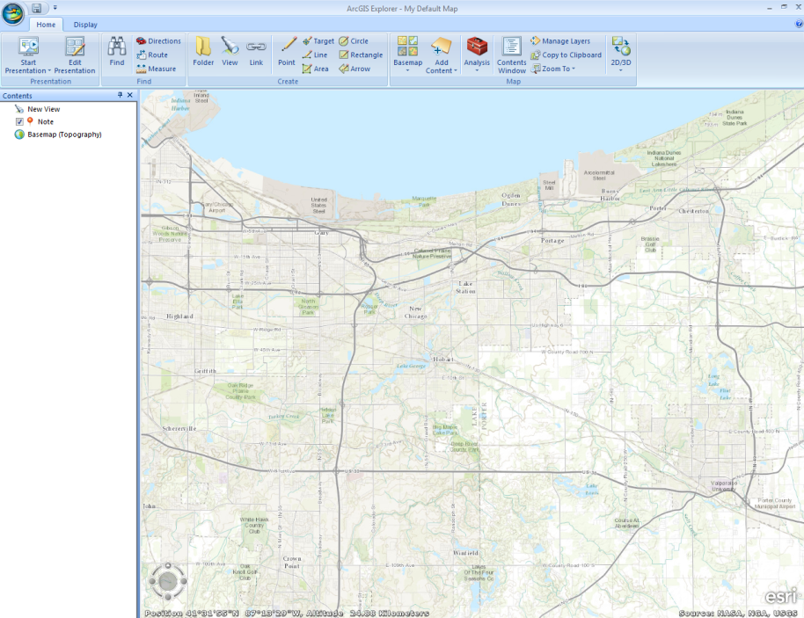
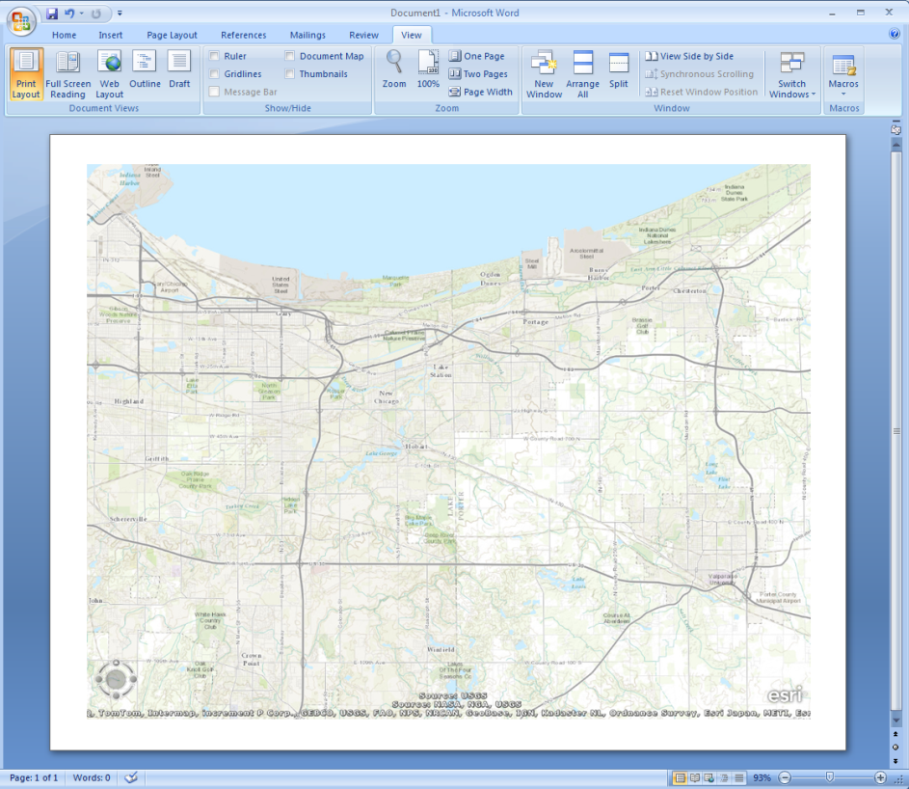
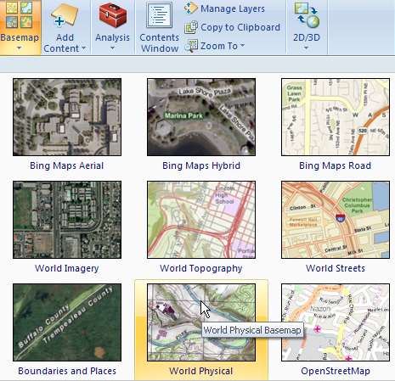
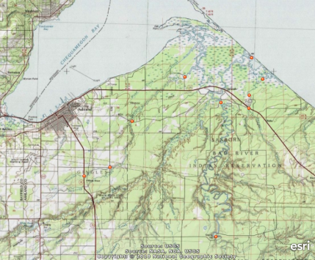
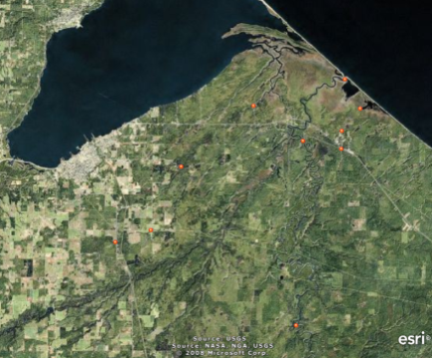
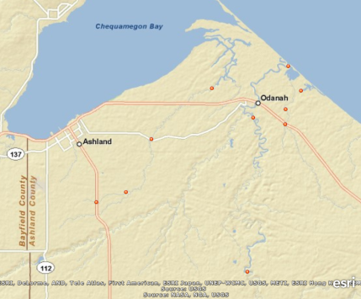
5. Create a Map Image
World Physical basemap Bing Maps Aerial basemap World Streets basemap

Slide 10
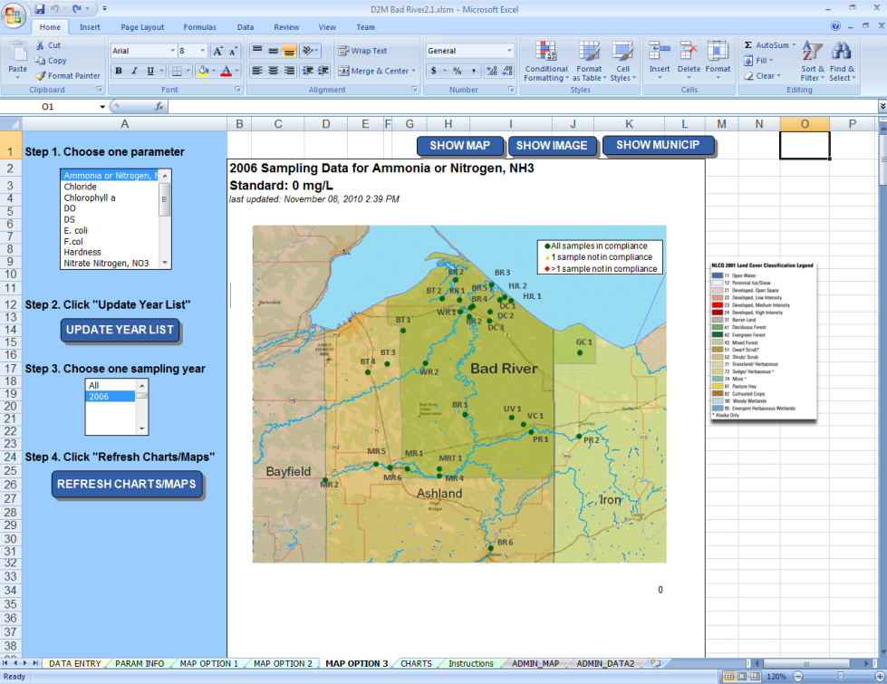
WhyData2Maps?
https://wiki.epa.gov/watershed2/index.php/Data2Maps
Why?
Free!
Customizable – use your own data
Spatial Sampling data Analysis
Geared toward storm water analysis
Notes:
Explain why we picked ArcGIS

Slide 11
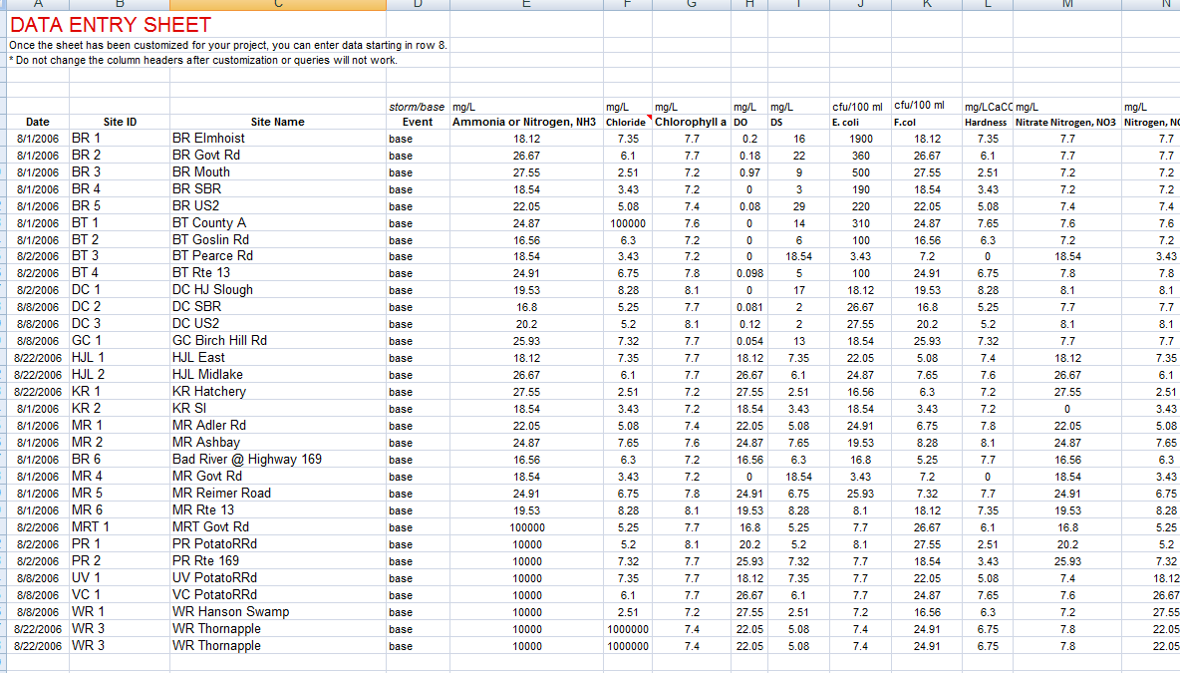
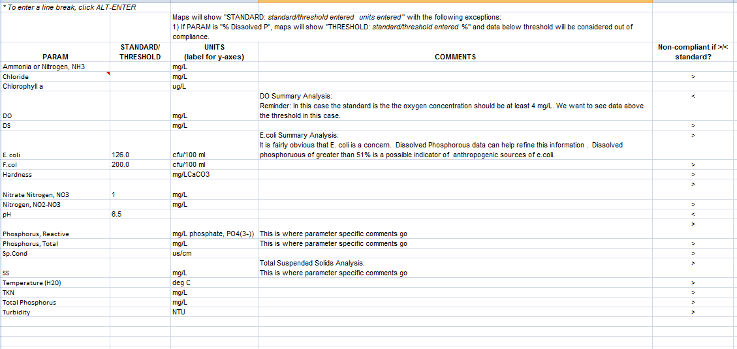

Slide 12
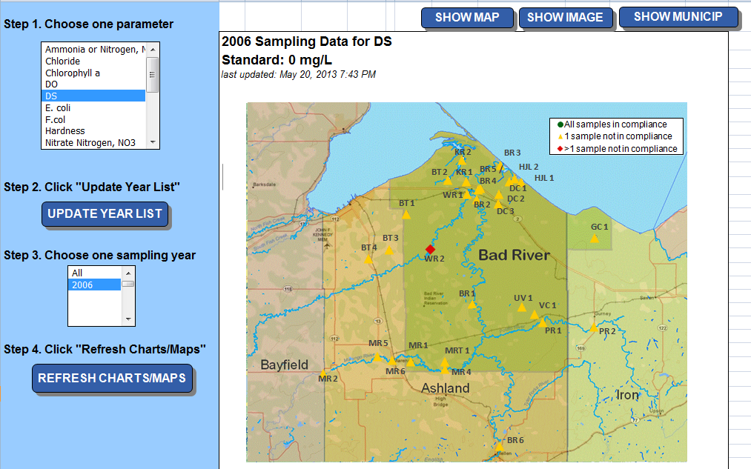
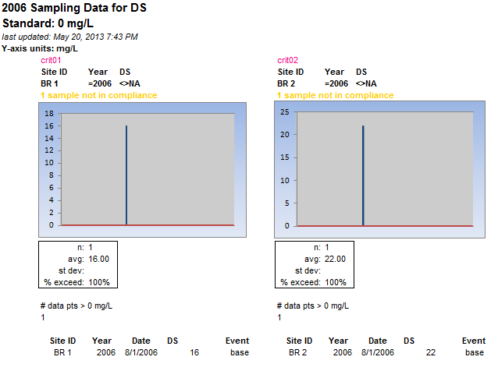

Slide 13
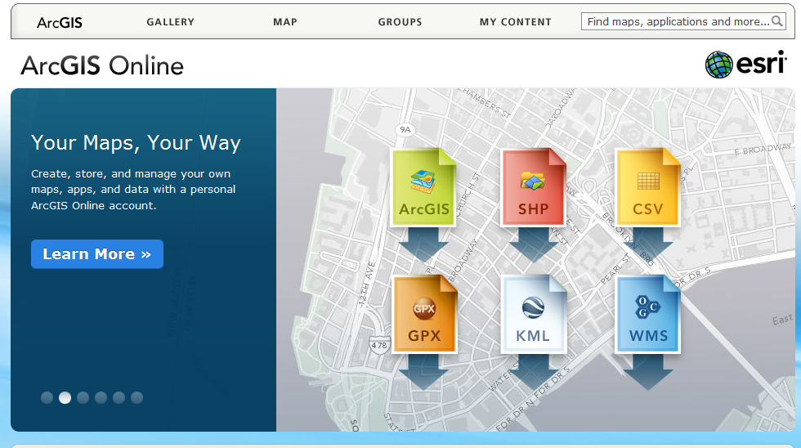
Why ArcGIS Online?
http://www.arcgis.com/about/features.html
Why?
Free!
Compatible with numerous basemaps and layers already available
Customizable – use your own data
Map production
Share Online maps
Notes:
Explain why we picked ArcGIS

Slide 14
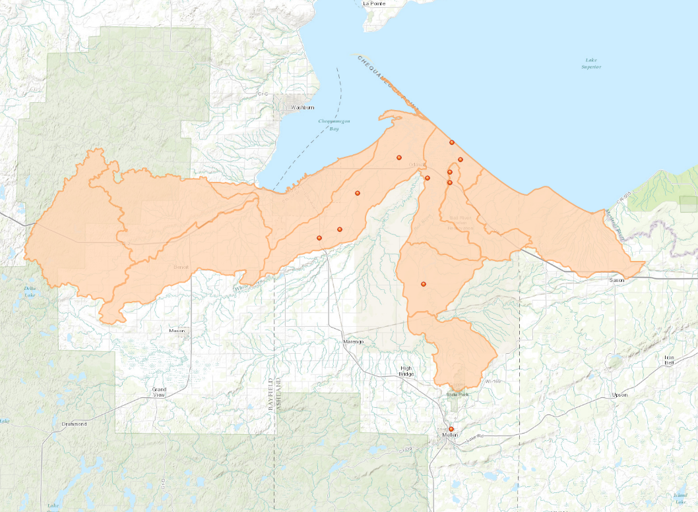
ArcGIS Online: Creating a Watershed Boundary Map
Notes:
Explain why we picked ArcGIS

Slide 15
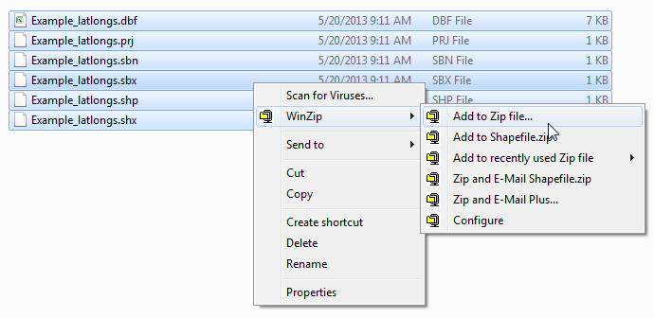
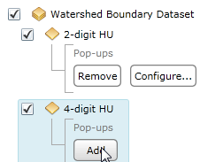
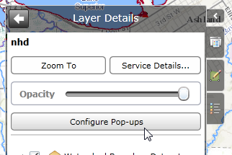
Download and Open ArcGIS Explorer. Open map.
2. Add Watershed Boundaries
A) adding a shapefile
B) query a map service, such as National Watershed Boundary Dataset (WBD)
or…

Slide 16
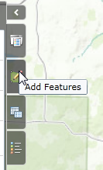
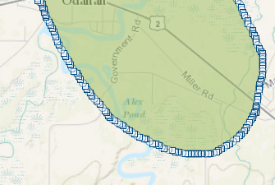
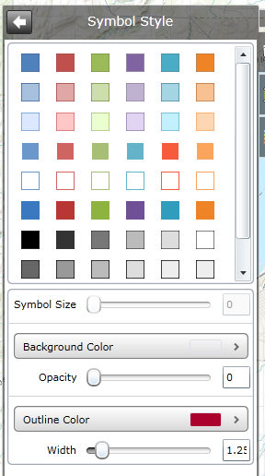
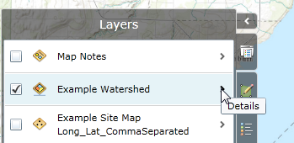
C) Draw approximate boundary with “note” tool
3. Changing the Symbology

Slide 17
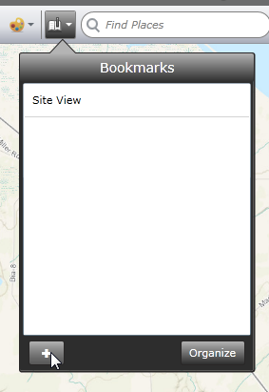
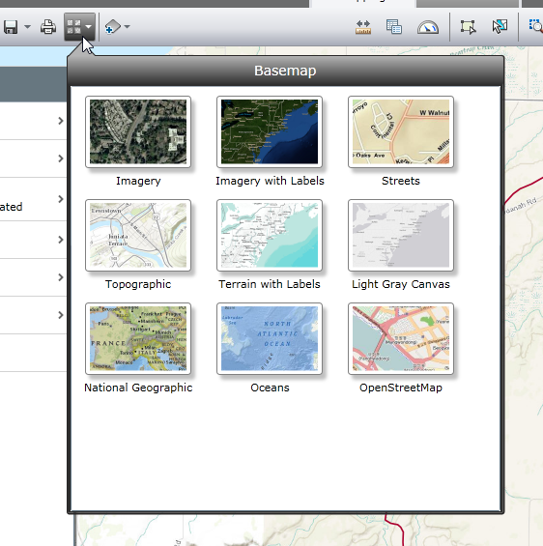
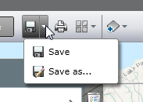
4. Bookmarking a view
6. Save map
7. Create map image or share map online
8. Access your map through your acount
5. Changing the Basemap

Slide 18
Tutorials available at:
http://bit.ly/IWLA-Tutorials

